Slide 1
Writing effective UCAS references

Slide 2
University of Birmingham / University of Bristol / University of Cambridge
Cardiff University / Durham University / University of Edinburgh
University of Exeter / University of Glasgow / Imperial College London
King’s College London / University of Leeds / University of Liverpool
London School of Economics and Political Science / University of Manchester
Newcastle University / University of Nottingham / University of Oxford
Queen Mary University of London / Queen’s University Belfast
University of Sheffield / University of Southampton / University College London University of Warwick / University of York
Notes:
Advancing Access is an initiative of the Russell Group of universities

Slide 3
Coming up…
The reference structure
Providing information about your school or college
Dealing with extenuating circumstances
Providing additional supportive information
Notes:
Use this slide to explain the structure of the session

Slide 4
The reference structure

Slide 5
The three sections of the new reference
For each applicant applying for entry from 2024 onwards, you will be able to enter a response in each of these three sections:
Enter a general statement about your school/college
If applicable, enter any information about extenuating circumstances which may have impacted the applicant’s education and achievement
Outline any other supportive information specific to the applicant and relevant to the course(s) applied for that you think universities/colleges should be aware of
Notes:
Completing the first section is compulsory (assuming the student is applying from a school or college) and you should expect to say something about every applicant in section 3 as well.
It is expected that section 2 will not be completed for most applicants.

Slide 6
Roles in the reference-writing process
Students
Complete their application and personal statement, which the referee should look at.
Senior leaders
Senior leaders at your school or college can agree on a statement about the school or college which is included in every reference
Subject teachers
Subject teachers may provide some input, though it may not be necessary for all subject teachers to contribute
Form tutor
A form tutor might be the one who draws together all the information needed to complete sections 2 and 3 of the reference
Notes:
You will need to decide which subject teachers should provide comments according to the course the student is applying to (for example, a subject which is being applied for or is a pre-requisite for the course being applied for). For students that are applying to the most competitive universities, you may wish to include comments from all the applicant's subject teachers.

Slide 7
Things to consider
Applicants will be provided with a copy of their reference if they request it from UCAS
The maximum length remains as 4,000 characters, this will be the total limit across the 3 sections
You can begin writing the reference once the applicant registers with UCAS
You can write the reference in Word and save your own copy (securely and not indefinitely)
You can read applications in the UCAS portal and make sure that references correspond well with applications
Notes:
UCAS will be analyzing how many characters tend to be used and how these tend to be split across the three reference sections. They may refine the character limit in future in light of this.
You should have a process for the deletion of references in you school or college so that you aren’t keeping this information longer than is necessary.

Slide 8
Section 1
Enter a general statement about your school/college/centre

Slide 9
School overview
You might set the scene by stating…
What type of school is it? For example, state funded or independent, sixth form or FE college, single-sex or coeducational?
How big is the school/sixth form/college? And what are the class sizes?

Slide 10
Details of your qualifications policy
What types of qualifications do you offer?
When students take A levels, how many do they take? Do they take externally accredited AS levels?
Are additional qualifications available, such as the EPQ, Core Maths or the Welsh Baccalaureate?
Are there any combinations of subjects which are not possible?
How do you arrive at predicted grades? Are there some qualifications you don’t predict for?
Do you have any particular entry requirements?
Notes:
Universities find it useful to understand the qualifications policy at your school or college as this helps them to contextualise students’ achievements.

Slide 11
Factors which could apply to you
High proportion of free school meals/pupil premium students
School or college serves disadvantaged community
High proportion of SEND students
School or college level extenuating circumstances (e.g. fire, flood, staff shortages)
Low Ofsted rating
Below average attainment level
Small proportion of students progress to university/Russell Group/Oxbridge etc.
Notes:
You might mention these factors if they apply to you and you think they’re relevant.

Slide 12
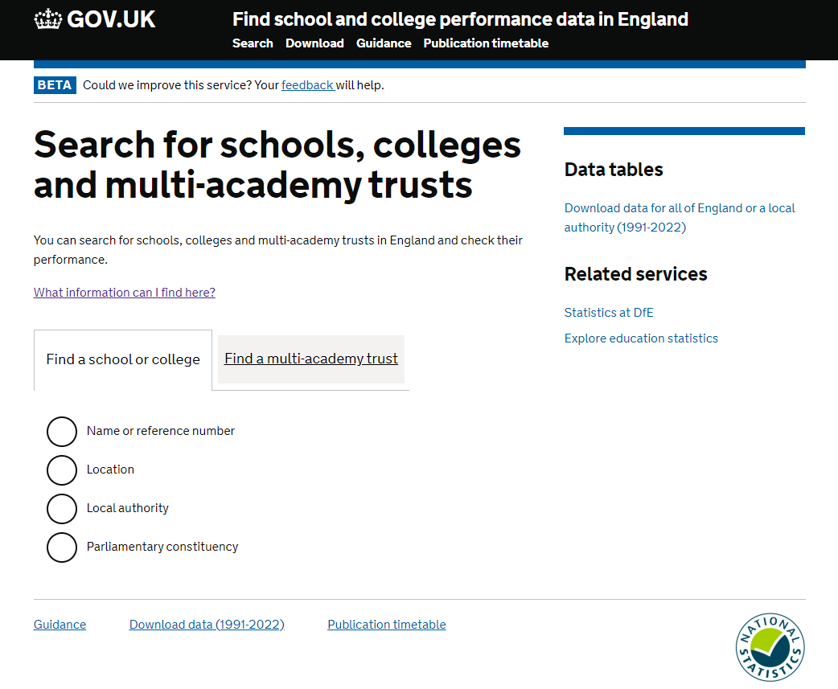
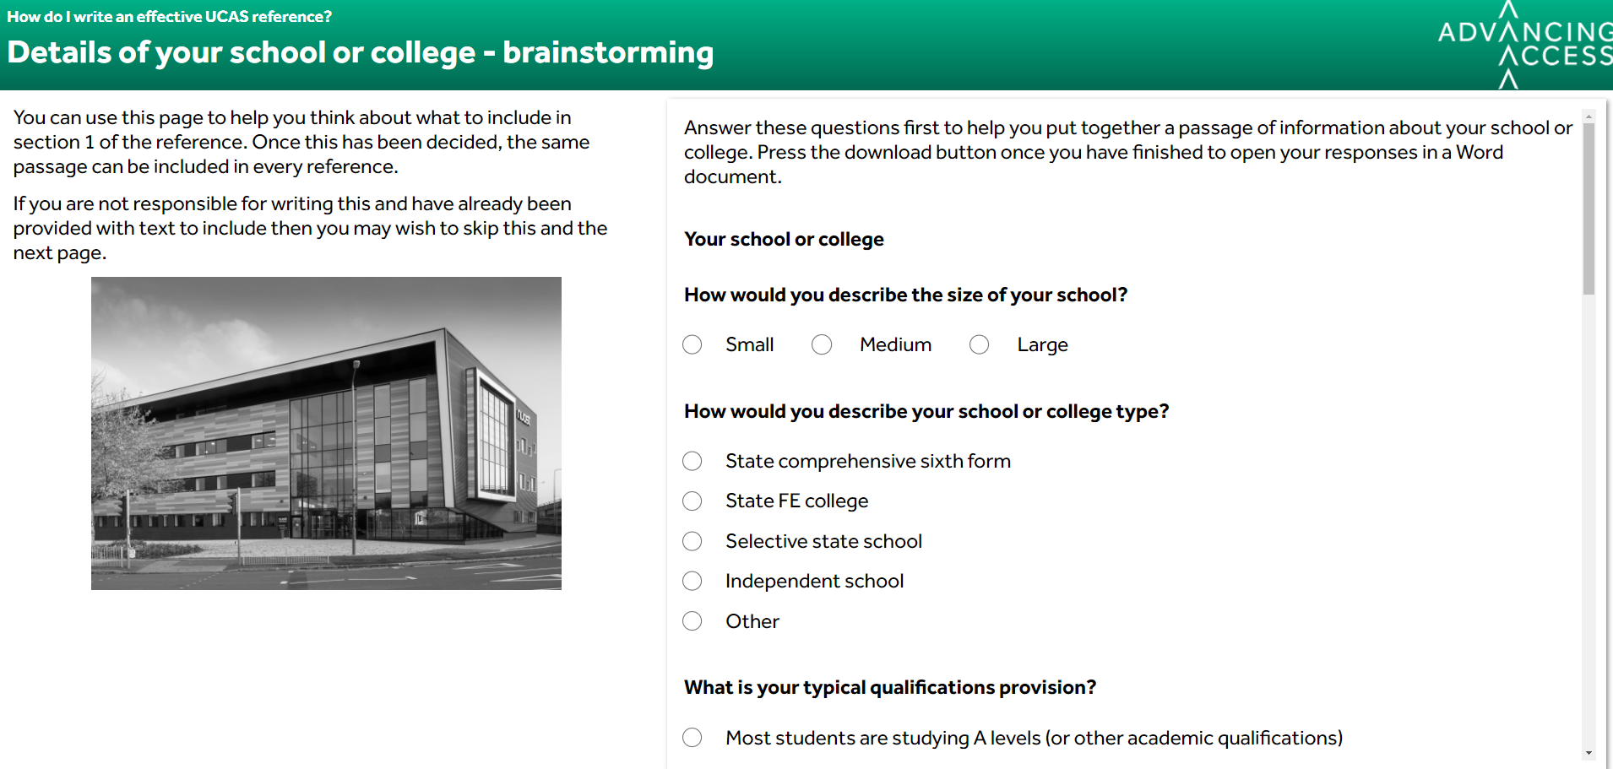
Useful resources
GOV.UK website for progression statistics
Advancing Access UCAS references CPD module
Notes:
The GOV.UK website is a useful place to find statistics about your school or college that you may include in section 1 (e.g. the percentage of students that progress to HE compared against national averages).
Our interactive module on ‘How do I write an effective UCAS reference?’ includes a tool that can help you to construct a statement for section 1.

Slide 13
Configuring the UCAS website
In the ‘Centre Management’ section of the UCAS portal, each application centre can add a template for use in section 1 of the reference.
Referees can then use the ‘add template text’ option to insert this template automatically
Notes:
Once a senior member of staff in your organisation has agreed upon a final version of a statement about your school or college, the same statement can be used for every application.
You can only have one reference template per centre. If you need more than one template, save these as Word files on your own systems ready to copy and paste in.

Slide 14
Section 2
If applicable, enter any information about extenuating circumstances which may have impacted the applicant’s education and achievement

Slide 15
Possible extenuating circumstances
Disability or special educational needs
Illness
Bereavement
Caring responsibilities
Multiple teachers in a short space of time
Student looked after in care
Applicant is refugee or asylum seeker
Lack of access to necessary technology
Lack of suitable study environment at home
Limited choice of subjects (at an individual level)
Other adverse circumstances
Notes:
This list is not exhaustive but gives you an idea of some of the possible extenuating circumstances you might include in this section.

Slide 16
Attainment trajectory
You could offer some commentary on actual or predicted attainment in section 2, for example:
There is a mismatch between actual grades at GCSE level and predicted grades at A level (or equivalent)
The student is not predicted to meet the advertised entry requirements of the course
Notes:
You don’t need to state predicted grades as these are entered elsewhere.
In section 2 you may also tell the university if there is any particular support you have put in place to enable the student to succeed at school or college as universities may be able to offer similar support themselves in future.

Slide 17
General points
Seek the consent of the applicant first before including anything sensitive
You should still mention extenuating circumstances that the applicant has chosen to mention themselves in the personal statement
You can also flag extenuating circumstances with exam boards, though you should mention you have done this in the reference to avoid ‘double counting’
References cannot be amended once submitted. If extenuating circumstances emerge further down the line, contact universities to tell them
Some universities may have their own extenuating circumstances form to fill in, especially in cases where applicants have faced particularly difficult circumstances (if you have sent a separate form you can state this in the reference)
Notes:
You can look on university websites to find out if they also have an additional extenuating circumstances form.

Slide 18
Section 3
Outline any other supportive information specific to the applicant and relevant to the course(s) applied for that you think universities/colleges should be aware of

Slide 19
Section 3 – supportive information
This is your chance to provide other relevant information to support the application
This is not necessarily the place to add everything you would have put in the ‘old’ reference – you may write a little less than you did in the past
When supporting applicants for some of the most competitive universities, expect to write around 2,000 characters in this section

Slide 20
Supportive information
You might provide details of:
Evidence of the applicant’s suitability for the course
Details of relevant work experience which has been completed (it may not be necessary to include part time jobs)
Challenges in balancing school or college work with other responsibilities
Positions of responsibility, e.g. Head Girl or Class Representative
Relevant extra-curricular activities
Verification of things mentioned in the personal statement (which are not verified elsewhere)
Notes:
The most important thing to remember is that detail provided in this section should be relevant. Quality is better than quantity and providing unnecessary detail can make it more difficult for universities to identify the important information included in this section.

Slide 21
Academic information
Details of academic skills and achievements in relevant subjects (for example, a subject which is being applied for or is a pre-requisite for the course being applied for)
Information about super-curricular activities and evidence of engagement with a subject outside of the school or college syllabus
Details of students who are near the top of their class in particular subjects
Information can be presented in bullet point style
You may not need to cover all subjects the student is studying
Notes:
Super-curricular activities are those that directly relate to the course that the student is applying for (e.g. playing the piano would be a super-curricular activity for a student that was applying to study music, but extra-curricular otherwise).
Presenting information in bullet point style can help universities identify important information quickly.

Slide 22
Details of barriers
You might describe in this section certain barriers the student has faced or could face, such as:
Barriers in accessing suitable work experience opportunities
Factors which might affect an applicant’s performance in an interview
Difficulties a student may have faced in putting together a portfolio for an art or design course

Slide 23
Other resources

Slide 24
Additional resources
From Advancing Access:
Request a free CPD session in your school or college
'How do I write an effective UCAS reference?' interactive CPD module
'How do I help my students apply to university?' resource strand
Sign up to our mailing list
From UCAS:
Changes to undergraduate references for 2024 entry

Slide 25
Questions?
enquiries@advancingaccess.ac.uk
@AdvancingAccess
University of Birmingham / University of Bristol / University of Cambridge / Cardiff University
Durham University / University of Edinburgh / University of Exeter / University of Glasgow / Imperial College London
King’s College London / University of Leeds / University of Liverpool
London School of Economics and Political Science / University of Manchester / Newcastle University
University of Nottingham / University of Oxford / Queen Mary University of London / Queen’s University Belfast
University of Sheffield / University of Southampton / University College London / University of Warwick / University of York

